Slide 1
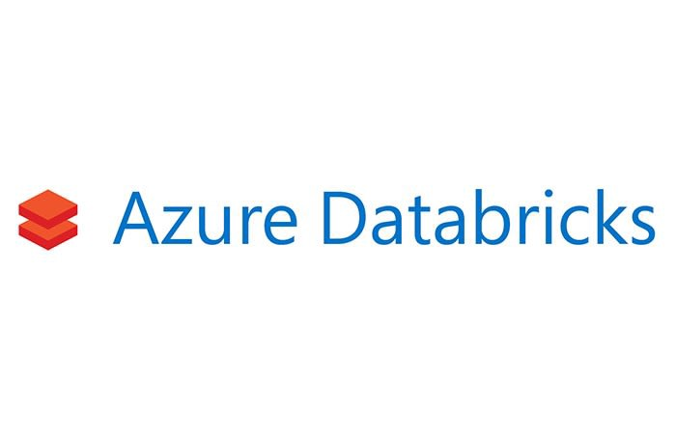
Introduction to Advanced Analytics on Azure Databricks
Will Velida
Graduate Software Engineer – ASB Bank – New Zealand
@willvelida
Notes:
Good morning everyone! Welcome to this introductionary session to performing Advanced Analytics on Azure Databricks,
My name is Will Velida and I’m a graduate engineer from ASB Bank in sunny New Zealand (even though it’s winter right now and it’s nice to be in some actual sun)
If you are in the wrong session or you need to make a quick exit, don’t worry I won’t be offended ☺
But for everyone’s information the safety exists are (insert joke)

Slide 2

About Me
I’m not actually a Kiwi!
Lived in NZ for 8 years (2 in Christchurch, 6 in Auckland)
From Rugby Player to Student Politician to Microsoft Intern to Software Engineer.
Big Data, Data Science and Cloud Engineering
Notes:
In case you haven’t figured it out or you’re looking at me thinking ‘that’s not what a kiwi sounds like”, you’re right!
I’ve lived in NZ now for 8 year (approaching 9). I spent two years living in Christchurch, played some rugby, survived some earthquakes before moving up to Auckland to study
Thought I’d do better with volcanos then earthquakes.
I’ve done quite a few things during my studies, I’ve been a student politican fighting the man ;), I’ve interned at Microsoft in New Zealand doing a bit of marketing for the technical evangelist team as it was called back then
That inspired me to change from business to Software Engineering, where I’ve worked as an intern for a health company and now I work for a bank!
While at the bank, I’ve been lucky to rotate between working with the Big Data engineering team, then spending a bit of time with the Data Science team helping them to understand how to use Apache Spark and Databricks and now I’m working in our Payments division doing some awesome things in the cloud. So it’s fair to say I’ve been around a bit.

Slide 3
What we’re going to talk about today
What is Apache Spark and Azure Databricks?
Setting up Databricks
Advanced Analytics and ML in Databricks
Visualizing your data.
Working with our data in Databricks
Notes:
- I’ll just go over briefly what Apache Spark is and how that ties in with Databricks
- Setting up Databricks and getting your data into it.
- Working with our data in Databricks, What types of data we can use and what Data Sources we can use with Databricks
- Using Databricks for Advanced Analytics, finding out how to set up a Databricks ML cluster and how we can use Spark Mllib, Mleap and Mlflow for our Machine Learning Pipeline
- Using and presenting your data within Azure Databricks and how we can connect our Databricks clusters to external tools like Power BI
- Q&A

Slide 4
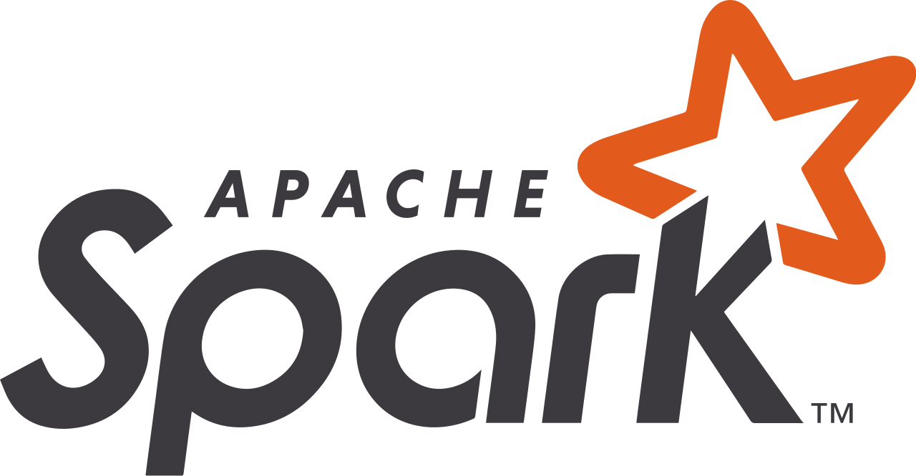
“A unified computing engine and a set of libraries for parallel data processing on computer clusters”

Slide 5
Apache Spark Ecosystem
Spark SQL + DataFrames
Streaming
MLlib
Machine Learning
GraphX
Graph Computation
Spark Core API
R
SQL
Python
Scala
Java
Notes:
As you can see, Spark supports a wide variety of different languages, (R, SQL, Python, Scala and Java). I’ve even heard that there’s support for C# coming?!
Spark has the ability to run anywhere from our laptops to a cluster of several thousand servers
When we say Spark is unified, it provides a consistent set of APIs that allow us to perform a wide variety of analytics tasks
The Spark Engine allows us to combine these tasks while providing high performance
Spark can handle loading data from storage systems and performing computations on it, but it’s not a storage system within itself.
You can use Spark with other storage options such as Azure Blob Storage or S3, Hadoop, Cassandra, Kafka etc.
Spark focuses on performing computations on the data, and the API allows us to write largely similar applications so we our applications don’t need to worry about the data is stored.
Spark ships standard libraries with the engine and it can support a wide range external libraries

Slide 6


What is Azure Databricks?
An Apache Spark-based analytics platform optimized for Azure.
Provides an collaborative workspace for Data Engineers, Data Scientists and Business analysts.
A secure environment to run Apache Spark clusters in the cloud.
Notes:
So where does Azure Databricks come in? Essentially, Azure Databricks is a Apache Spark platform optimized for Azure.
It allows us to combine different users and stakeholders in one place, enabling Data Science and Analyst teams to be more agile and put themselves on the path for DevOps. This is a bit of a marketing title, but in my opinion this actually paves the way for agile Data Science.
Traditionally, Data Scientists would sit in their own team asking the Data Engineers for access to data,
Data Engineers for whatever reason, would say no and you’d have this ‘political blocker’ that would impact the business cases that we are trying to solve and our customers.
Azure Databricks also provides us with a secure environment to run our Spark clusters in the cloud. This includes:
- Integration with Azure Active Directory enables you to run complete Azure-based solutions using Azure Databricks.
- Azure Databricks roles-based access enables fine-grained user permissions for notebooks, clusters, jobs, and data.
- Enterprise-grade SLAs

Slide 7






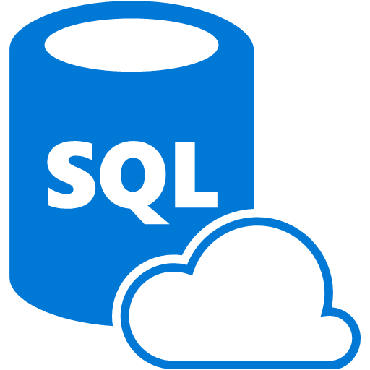
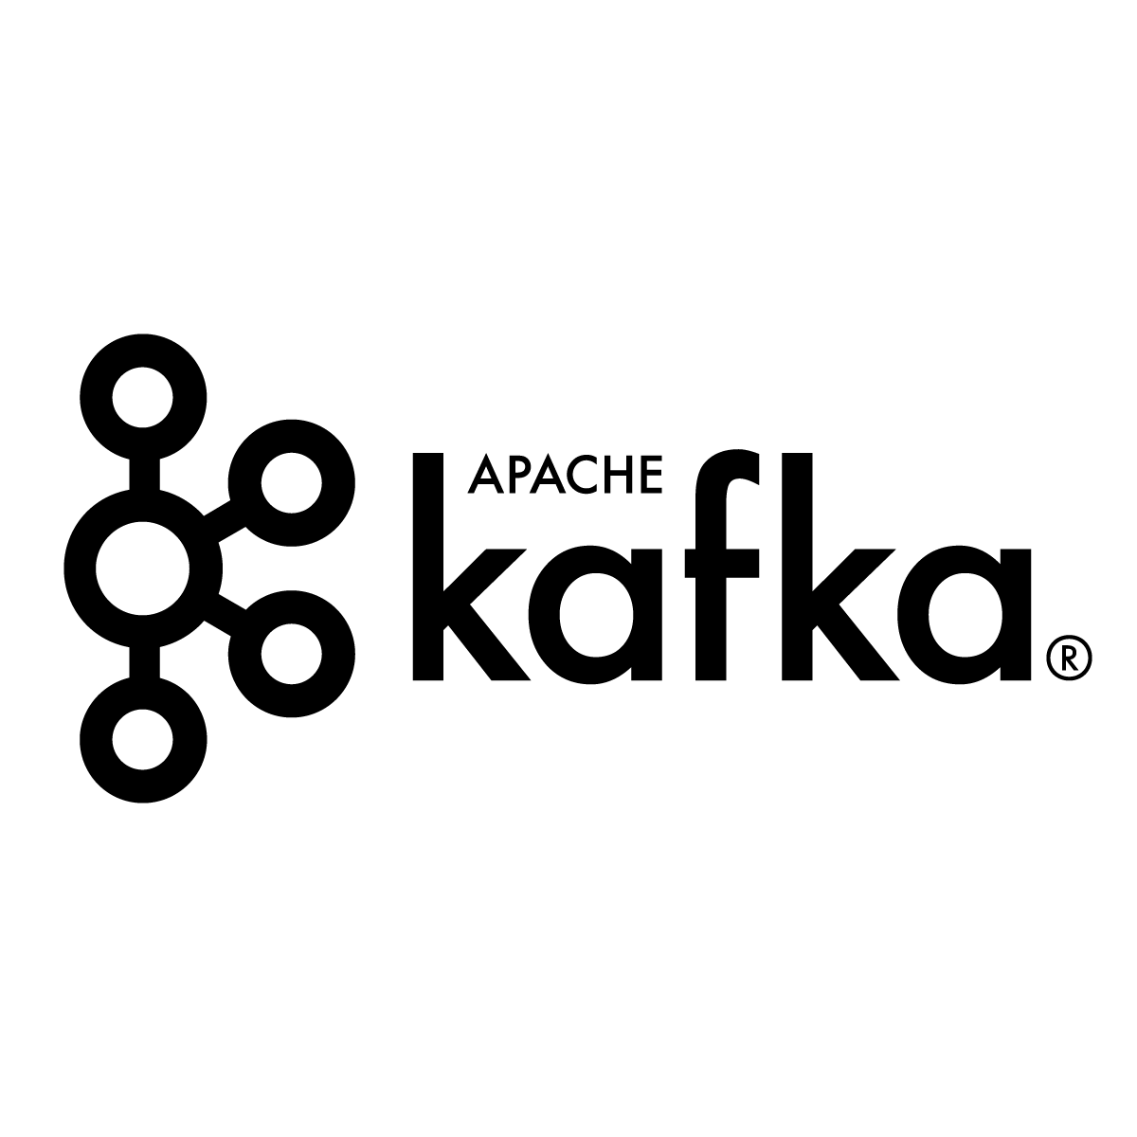


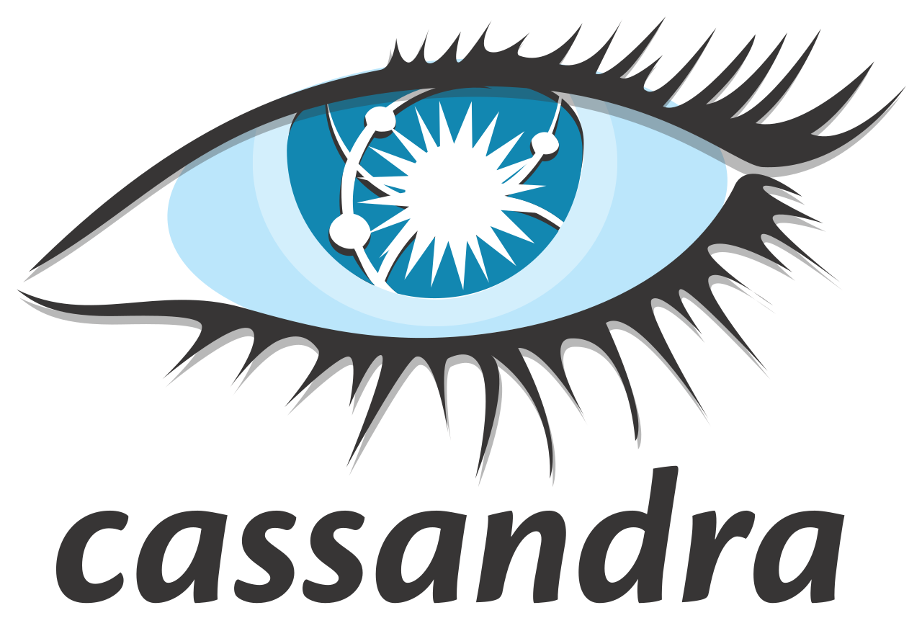
Sample Data Pipeline
Reports and business apps
Source Systems
Ingest
Store
Model
Train
Notes:
It’s important to view Databricks as part of our pipeline and not the only component of it. Earlier I talked about Spark provides APIs to allow us to work with different kinds of data
Take the following example, say we have a bunch of applications that provide raw data for us to work with. We use something like Kafka or Event Hubs to injest our data and store it in Blob Storage for long term persistence. We can then use Azure Databricks to read that data and work with it in a variety of ways. Later I’ll talk about what types of Machine Learning libraries are available to us but we can use Databricks to prep and train our models. We can then store the results of our data in a variety of different data stores and then use visualization tools such as Power BI or Databricks’s built-in visualization tools to provide relevant business users insights into our data.

Slide 8
Demo: Setting up our Databricks Workspace
Notes:
Let’s go through a demo! I’m going to show you how to set up a Databricks workspace in Azure, Create a cluster, create some folders, create and work with some notebooks,
Add some packages and show you the difference between Jobs and ad-hoc works
Set up a deployment in the portal
Set up a cluster
Setting up folders,
Create notebooks, jobs, packages.

Slide 9
Working with our data in Databricks

Slide 10





Support for many different file types
Notes:
Avro Files
Ever used Event Hub Capture
A fast binary data form
Commonly used for streaming data queries
Can be used for structured streaming pipelines in Kafka
CSV Files
- Tried and true
JSON Files
- Beautiful ‘schema-less’ data
Image Files
- Work with images
Binary Files
- In Public Preview
Parquet Files
- Columnar file format that provides optimizations. Speed up queries and is quicker than CSV or JSON
Zip Files

Slide 11



And Support for different data sources/sinks
Notes:
Wide variety of Data Sources
SQL Databases via JDBC
Azure SQL Database
Azure Blob storage
Data Lake Storage
Azure Cosmos DB
Azure SQL Data warehouse
Mongo DB
Neo4j
CouchBase
ElasticSearch
Snowflake

Slide 12
Demo: Simple Operations in Databricks

Slide 13
Advanced Analytics and ML in Databricks
Notes:
Let’s move onto the meat of it

Slide 14
Understanding Spark MLlib
Spark’s machine learning library!
Contains tools such as:
Algorithms
Featurization
Pipelines
Persistence
Utilities
Notes:
Mllib is Spark’s machine Learning library. It has a bunch of tools for machine learning such as:
- common machine learning algorithms such as classification, regression, clustering, and collaborative filtering
- Featurization: feature extraction, transformation, dimensionality reduction, and selection
- Pipelines: tools for constructing, evaluating, and tuning ML Pipelines
- Persistence: saving and load algorithms, models, and Pipelines
- Utilities: linear algebra, statistics, data handling, etc.

Slide 15
The Machine Learning Workflow in Spark
Raw Data
Estimators & Models
Transformers & Estimators
DB
Pipeline
Cross Validation
Pre-processing, cleaning and feature engineering
Clean and Structured Data
Tuning our model
CSV
JSON
Evaluators Metrics
Success
Evaluations
Structured APIs
Notes:
Here we have a typical workflow for machine learning.
First, we’ll gather data relevant for the problem that we’re trying to solve, whether that exists in our databases, data warehouses, raw files, wherever
We’ll then spend a majority of our time cleaning it to better understand our data.
We’ll then perform our feature engineering to ensure that the algorithms that we apply is on a dataset in the suitable form (converting data to numerical forms)
Splitting our data up into training set to determine which model will produce the result we want.
Evualting our models against success criteria that we set by applying it to our test data. This will help us determine how well our models will perform in production.
Leveraging our insights about our model or use our model to make predictions in production

Slide 16





Databricks Runtime for Machine Learning
Special ML Runtime that contains multiple popular libraries.
Ready to go environment for ML and Data Science
Multiple tools for hyperparameter tuning.
Great time-saver! No need to install our libraries manually!
Notes:
The Databricks Runtime for Machine Learning provides a ready-to-go environment for ML and Data science.
The ML Runtime is built of top of the ordinary runtime.
Basically it contains multiple popular libraries already installed on the cluster which substainally speeds up cluster start-up!
Also handles compatibility between different libraries
Databricks designates a subset of supported libraries as top-tier,
For these Databricks provides a faster update cadence, updating to the latest release of that package with each runtime release.
Databricks also provides support, testing and optimization for top tier libraries.
These include GraphFrames, Tensorflow, PyTorch etc.
You can also install Python packages using Conda, however you can’t activate or switch environments

Slide 17
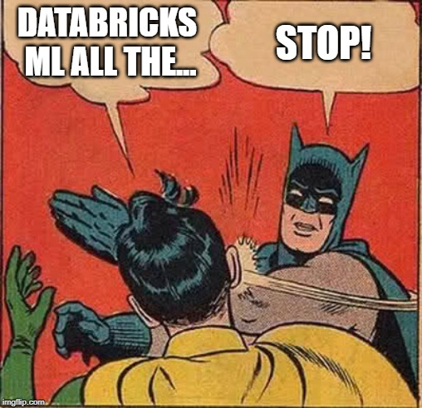
WARNING
MPI communication protocol
Risky for sensitive data
XGBoost, Horovod and Distributed Tensorflow
Notes:
Databricks Runtime ML includes ML Packages that use Message Passing Interface and other low-level communication protocols that do not natively support encryption over the wire
This can potentially be a security risk as you will send sensitive data across the network
As far as I know, this includes XGBoost, Horovod and Distributed Tensorflow.

Slide 18
Ok? How can we export our models?
MLeap
Serialization format and execution engine for ML pipelines.
Can serialize Spark, Tensorflow and scikit-learn pipelines into a bundle so we can load models with new data
Databricks ML Model Export
These exported Models and Pipelines can be imported to do scoring and make predictions
Notes:
After we’ve developed our models, we’ll want to productionize them (what’s the point otherwise?). Typically, we would
Export a trained model
Import the model into an external system.
Azure Databricks supports two methods to export and import models and full ML pipelines from Spark.
Mleap
Provides simple interfaces to execute pipelines for ML.
Models are portable as Mleap Bundles, which is good if you don’t wish to be locked into a particular vendor. You can take your model wherever you go
One runtime for us to use. It’s a case of simply exporting to an Mleap Bundle and running our pipeline wherever it is needed.
Databricks ML Model
- Databricks ML Model Export is used to export models and full ML pipelines from Apache Spark.
These exported models and pipelines can be imported into other (Spark and non-Spark) platforms to do scoring and make predictions
Model Export is targeted at low-latency, lightweight ML-powered applications
However, Databricks ML Model Export is depreciated in Databricks Runtime 5.3 and 5.3 ML and will be removed in 6.0, so we will focus on Mleap instead

Slide 19

Open source platform for managing end-to-end ML pipelines
Three Primary components
Tracking: Allow us to track experiments.
Models: Allows us to manage and deploy models from a variety of ML libraries
Projects: Allows us to package our ML code in a form that we can share it.
Notes:
1.0 was released at the start of the month!
We can track experiments to record and compare parameters and results.
We can manage and deploy our models from a variety of ML libraries to different model serving platforms.
We can then package our ML code in a way that’s reusable and reproducable. This is great for when we want to share our code and models amongst data scientists or transfer to production.
Databricks provides a fully hosted and managed version of Mlflow that’s integrated with a bunch of cool features such as enterprise security, high availability, running experiments etc.
You can run MLFlow on the command line (available as a pip package), view results using the UI (available as another pip package) and save models all via the command line, but we can do this in Databricks automatically.

Slide 20
Demo: Machine Learning in Azure Databricks!
Notes:
Let’s now use the cluster we’ve created earlier to perform some basic machine learning, and export our model to MLFlow.
First we’ll look at Mleap to create our ML models, perist them to Blob Storage and then apply our model on a new set of data.
Then we’ll take a look a MLFlow

Slide 21
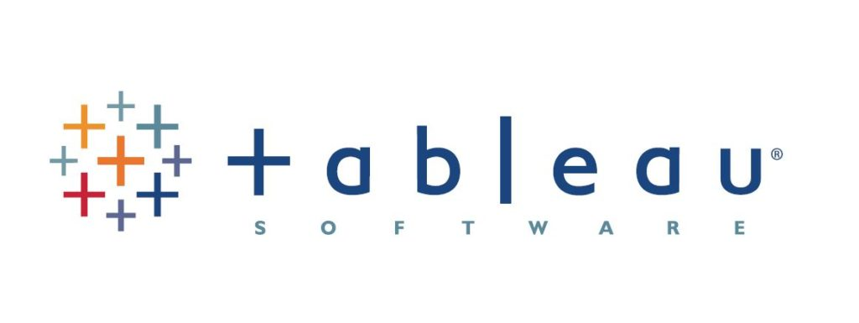

Visualizing your data.

Slide 22
Visualizing our Data
Out of the box support
Integration with visualization tools
Support for a wide range of data sources
Notes:
Databricks supports visualizations out of the box!
We implement visualisations in Databricks by using the display() functions. This also works for image data types and machine learning visualizations.
In Python, Scala and R notebooks, we can use the displayHTML function to pass in HTML, CSS and JavaScript code. Anyone here use D3? Well this is one way that you can use that library within Databricks.
Can connect your clusters to other visualization tools (Power BI, Tableau)
Another way is to export your data to a Data Source, then connect your visualization tool to that Data Source

Slide 23
Demo Visualizing our data in Power BI!
Notes:
Creating our visualizations in Databricks
Connecting our cluster to Power BI
Creating visualizations in Power BI

Slide 24
What we’ve covered today
What is Apache Spark and Azure Databricks?
Setting up Databricks and getting your data into it.
Working with our Data
Using Databricks for Advanced Analytics
Visualizing your data.

Slide 25
Before I go!
Only a part of your pipeline!
Databricks is a fast evolving product!
Involve your users, but look after your data
Do ML, Don’t be evil
Notes:
Please remember that Databricks and Spark is only a part of your pipeline. Use it in combination with other tools in your Data Arsenal.
If you’ve watched my demos and thought ‘that’s cool, but it would be better to do this” Great! That’s what it should be like in the real world
Databricks is a fast evolving product! It’s still not a complete product and some features that you may need in your production environments may not be available to you yet
First example, I was doing a demo on how we were using Databricks internally the day that they changed the UI. I hadn’t checked before the demo so it was mostly me struggling to find where things were!
On a more serious point though, When we first used Databricks, our security team wasn’t happy with the lack of logging available to them (finding out what users were querying, which datasets they were performing computations against etc). This has changed now, but from first hand experience make sure that it fufils all your criteria before investing in it.
Make sure you know where your data is being stored, how it’s being stored and how your users are using the data that’s going through your data pipeline. It’s an obvious point (or at least it should be) but ensure that your data is of high quality and is being used for the correct purpose. Data is used a bit as a buzzword these days, but how we use it has a real impact on our customers livelihoods.
Finally, this is a point that has been raised at every AI/ML/Big Data talk I’ve been to so I’ll repeat it here. If you’re doing Machine Learning and AI, or planning to, please don’t be evil. Use Machine Learning as a competitive advantage, but make sure that you practice ML in an ethical manner

Slide 26
Want to learn more?
Check out the Azure Databricks documentation!
Apache Spark programming guide.
Databricks modules on Microsoft Learn.
Spark: The Definitive Guide book.
Spark + AI Summit Sessions.
Notes:
The documentation has lots of information on Databricks the product itself!
The best guide for programming in Spark is the programming guide.
Microsoft Learn have some fantastic modules on Azure Databricks that you should check out.
If you want to learn more about Apache Spark in general, I’d definitely recommend getting your hands on the Definitive Guide book (It’s written by the founders of Spark so they might know a thing or too)
Check out the Spark + AI summit sessions too! Some great sessions that can go real deep technically!

Slide 27
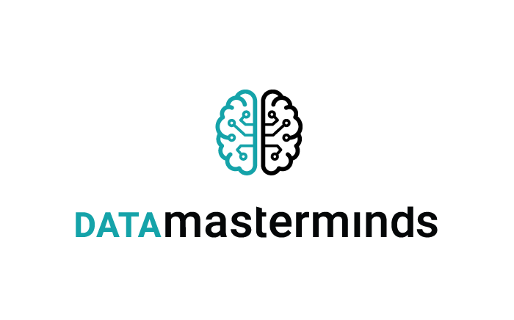









Notes:
Thanks to our Sponsors for making DataGrillen happen!

Slide 28

Session Feedback Day 1 (not optional!)
http://bit.ly/DataGrillen2019Day1
Notes:
Got feedback for me? This is my first time so I’d love to hear your thoughts on how you think the session went?

Slide 29

Event Feedback (not optional!)
http://bit.ly/DataGrillen2019Event

Slide 30
Thanks for attending!
Notes:
Thanks for listening to me, I hope you got something out of it
I have twitter but I don’t like it, so hit me up on LinkedIn, come and get a beer with me later at the Grillen.
But before we go for lunch, any questions?

